Slide 1
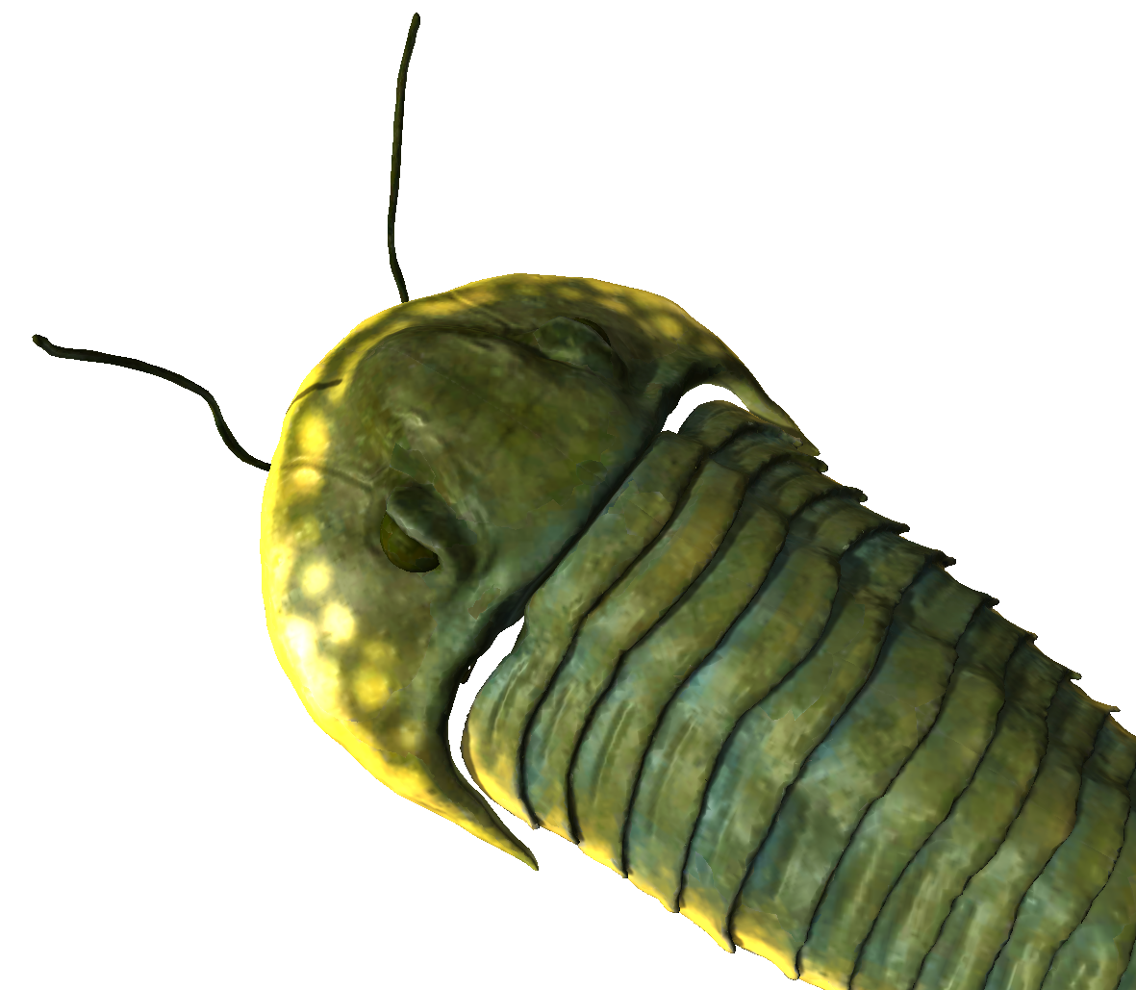


Duration: 50 min
High School
Grade: 9 - 12
CCSS, NGSS
Earth‘s history:
Spread of life
Earth and space science, Geology, Life science, Plant Biology, Animal Biology, Paleontology
Click to open in Lifeliqe

Slide 2

Lesson overview
The planet Earth has a more than 4.6 billion year history, over the course of which it has undergone substantial changes in the conditions it offers life. All living organisms have had to adapt to these changes; those that were unable died out. However the survivors have also contributed to the creation and alteration of these life conditions. This process of mutual influence between different elements of the environment is called coevolution, and it has contributed considerably to changing our planet.
Learning objectives
Keywords
Learn about the evolution and development of Earth and of the life forms which have inhabited it since its creation.
Understand the factors which have contributed to the formation of the environments on Earth over its history.
Observe the mutual influence of living nature on Earth’s systems.
Bacteria, Prokaryotes, Eukaryotes, Animal Cell, Plant Cell, Soil, Geologic ages
Standards
Common Core
CCSS ELA-Literacy SL.9-10.1
Initiate and participate effectively in a range of collaborative discussions (one-on-one, in groups, and teacher-led) with diverse partners on grades 9–10 topics, texts, and issues.
SL.9-10.4
Present information, findings, and supporting evidence clearly, concisely, and logically such that listeners can follow the line of reasoning and the organization, development, substance, and style are appropriate to purpose, audience, and task.
SL.9-10.5
Make strategic use of digital media (e.g., textual, graphical, audio, visual, and interactive elements) in presentations to enhance understanding of findings, reasoning, and evidence and to add interest.
NGSS
HS-ESS2-7
Construct an argument based on evidence about the simultaneous coevolution of Earth’s systems and life on Earth.

Slide 3
1. Introduction
30
min
In the first two lessons in this series (“Earth’s history: The beginning” and “Earth’s history: The blue planet”), we discussed the formation of our planet and the subsequent moderation of the extreme conditions on its surface. This lesson will be dedicated to the expansion of living organisms in Earth’s oceans and to their later colonization of dry land. This was the beginning of the evolution of the variety of life seen during later periods of the history of our planet. Begin the class with a review, discussing with students the previous development of the planet:
What was Earth like after its formation from the solar nebula?
How were the conditions on its surface and in the atmosphere after its surface cooled down?
Which conditions made the appearance of life possible on our planet?
And which conditions are crucial for its survival today? Are these different from those which held when life first appeared?

Slide 4
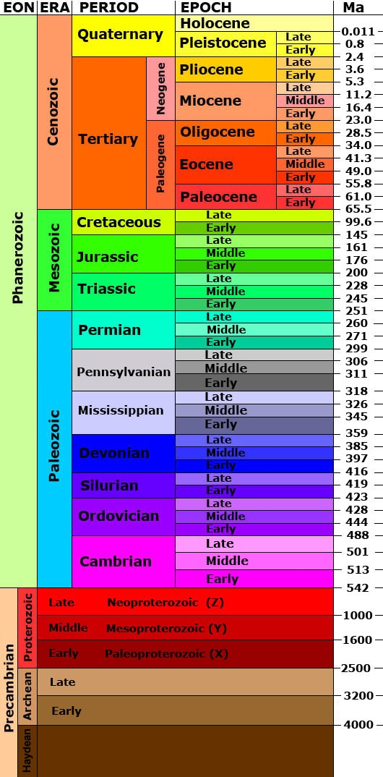
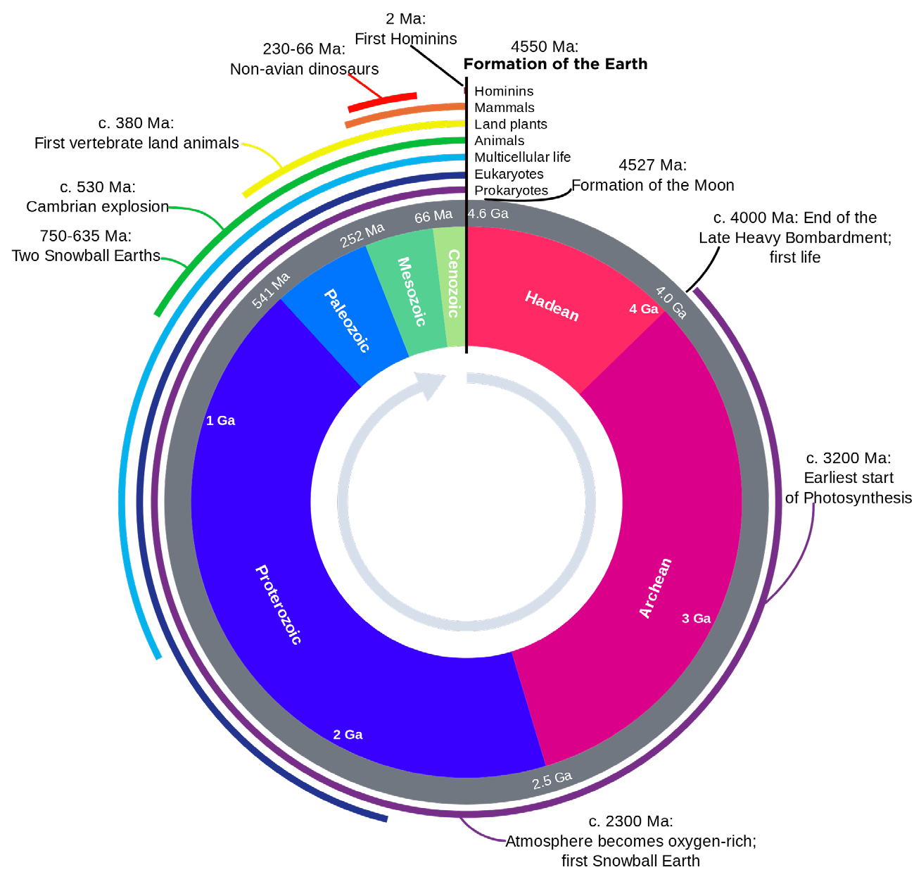
2. Geologic ages
30
min
As an introduction to the subsequent chapters in Earth’s history, familiarize your students with the overall system of its geologic history. This systematization will serve you well while introducing new information, as its periodization mainly depends on the crucial changes of life forms on Earth. Inform students that to start with, the geologic history of Earth is divided into very long periods called eons, four in total. Of these, three (the Hadean, the Archean and the Proterozoic) cover that majority of Earth’s history prior to the great diversification and spread of life forms. Show the time scale of the geologic ages of the Earth, and allow students to observe the periodization!
Eons are subsequently divided into eras, periods, and epochs. The various subdivisions are defined by characteristics regarding changes in life forms. The first eon, the Hadean, was that early period of extreme conditions with intense bombardment of the planet and no life, as discussed in the lesson plan “Earth’s history: The beginning”. The second eon, the Archean, was that characterized by the formation of early life conditions, as discussed in the lesson plan “Earth’s history: The blue planet”. The third, the Proterozoic, and fourth, the Phanerozoic, include the development of more complex life forms, as prokaryotes evolved into eukaryotes, and later into the multicellular organisms which subsequently diversified into various species of plants, animals, etc. Before continuing, take a look with your students at this geologic clock, which can be very helpful in systematizing and periodizing all the knowledge acquired in these lessons!
Woudloper Derivative work: Hardwigg, Geologic Clock with events and periods, marked as public domain, more details on Wikimedia Commons
United States Geological Survey, Geologic time scale, marked as public domain, more details on Wikimedia Commons

Slide 5
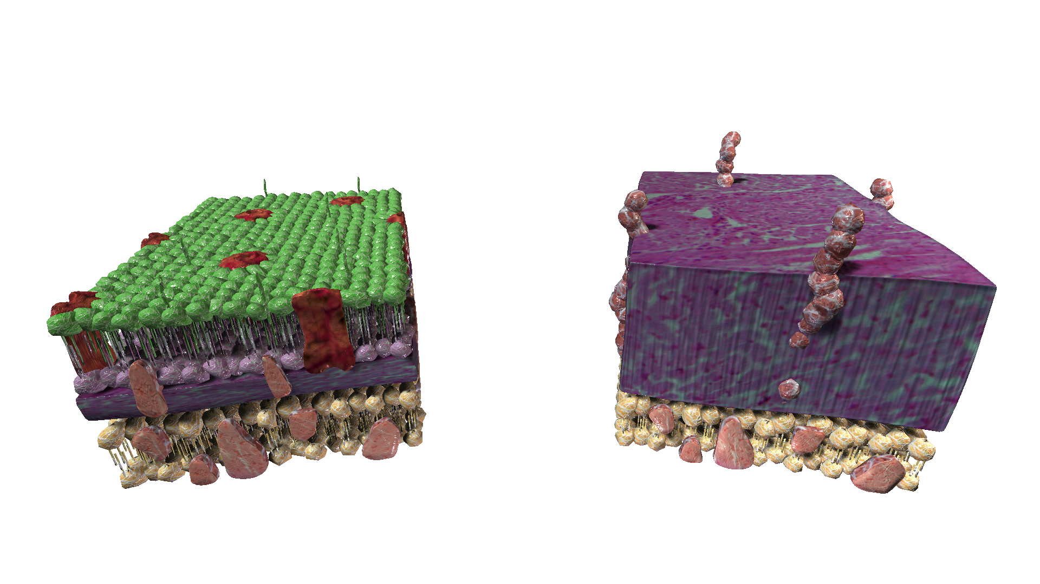
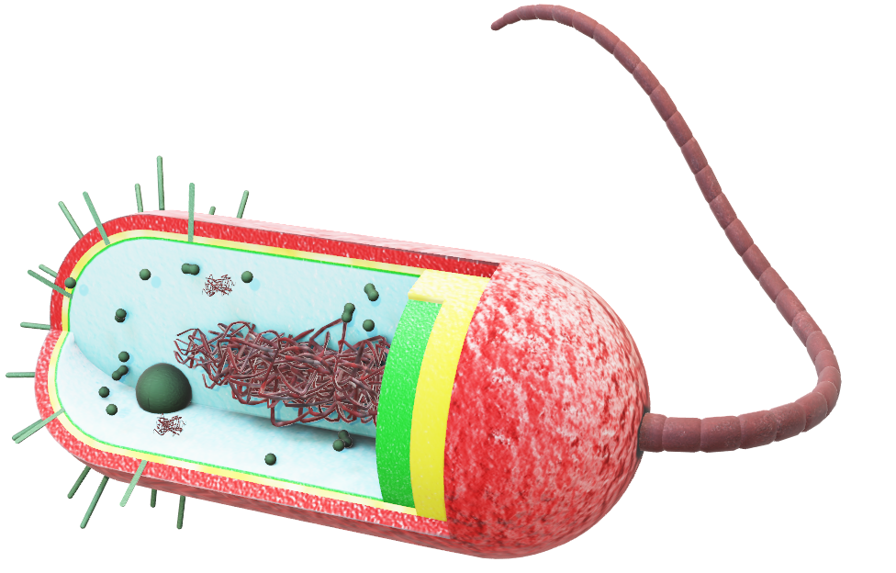
3. From prokaryotes to eukaryotes
15
min
As said before, the first organisms on Earth were very simple ones. Prokaryotes were primitive but extremely resilient forms of life. To see one of them, go to the Lifeliqe app, open the Animal Biology library, and look for the model called “Bacteria”. Observe the composition of its simple body. To observe the resistant cell wall of these organisms, open the “Cell Wall of Bacteria” model. Concentrate on its functions and composition!
Prokaryotes were rudimentary, single-celled organisms. To evolve more complex, multicellular organisms, there was a need for more sophisticated sorts of cells. Such cells appeared about 2 million years ago, at the beginning of the Proterozoic eon. The most probable way this happened was that a large prokaryotic cell attempted to trap and digest another, smaller one, which survived thanks to its resilient character.
Click on the model to interact
Click to open in Lifeliqe

Slide 6
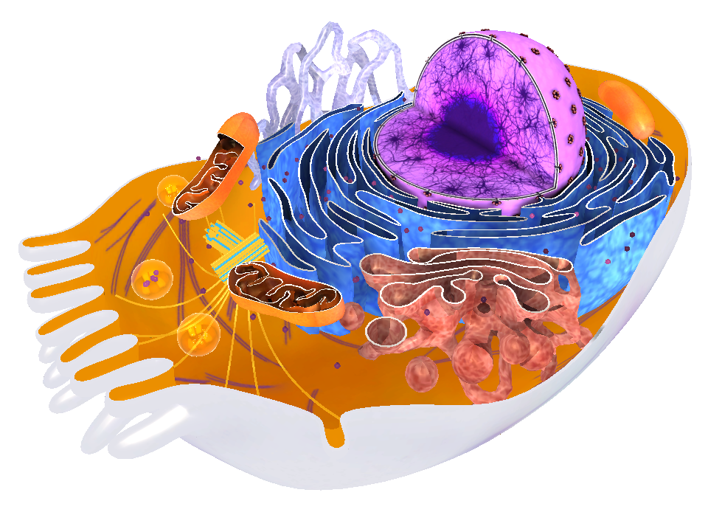
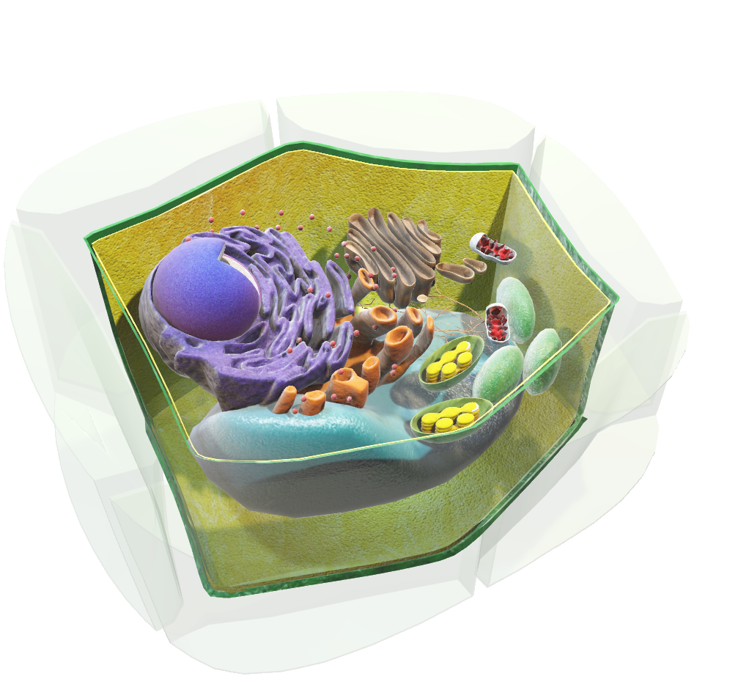
Soon, these cells began to live in symbiosis and need one another, the larger one dependent on the energy produced by the smaller, and the smaller one dependent on the raw materials contributed by the larger. The smaller organism eventually transformed into a type of organelle which we now call mitochondria.
You can find an example of this more complex eukaryotic cell in the Human Biology library of the Lifeliqe app, in a model called “Somatic Cell”. Show it to the students, describing the organelles and comparing it to the simple prokaryotic cell.
Another, second type of eukaryotic cell is what we call a “Plant Cell”, the model of which can be found in the Plant Biology library. This cell, unlike animal cells, contains an organelle called a chloroplast. This organelle serves for photosynthesis and probably evolved in a similar way as mitochondria: photosynthesizing cyanobacteria entered other cells and there transformed into chloroplasts.
Click to open in Lifeliqe
Click on the model to interact

Slide 7
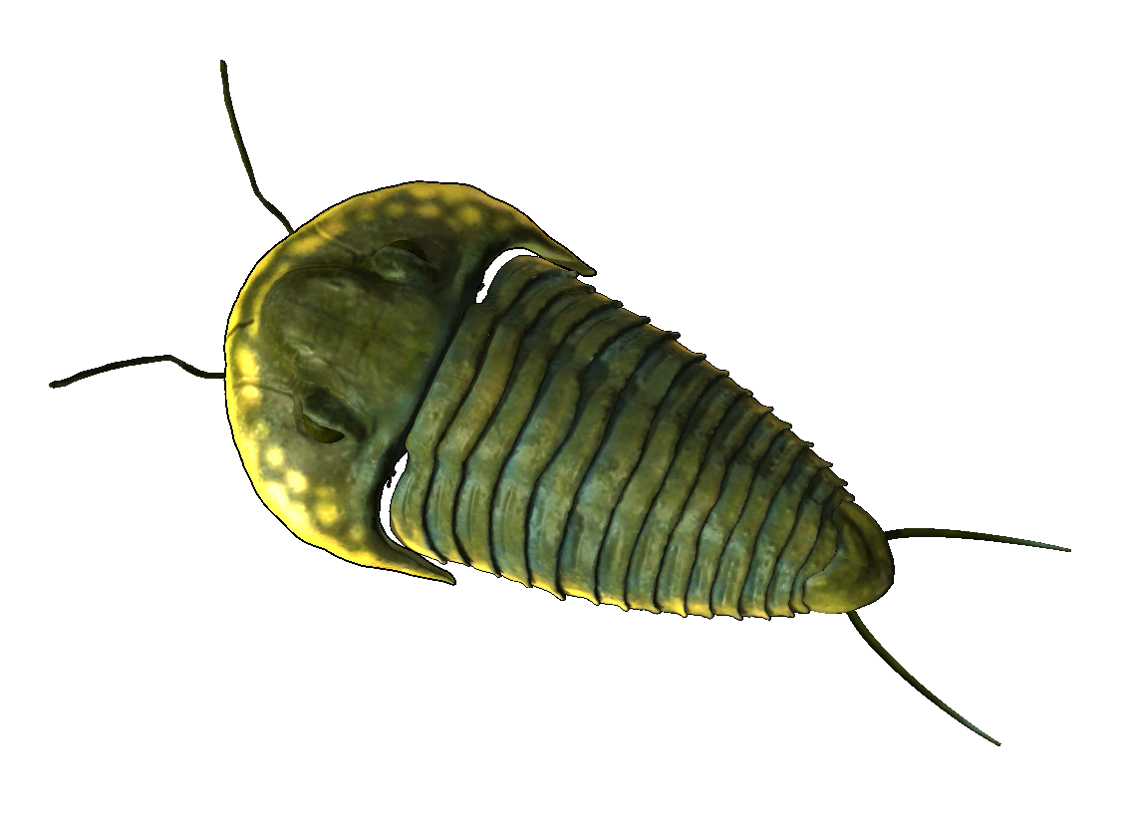
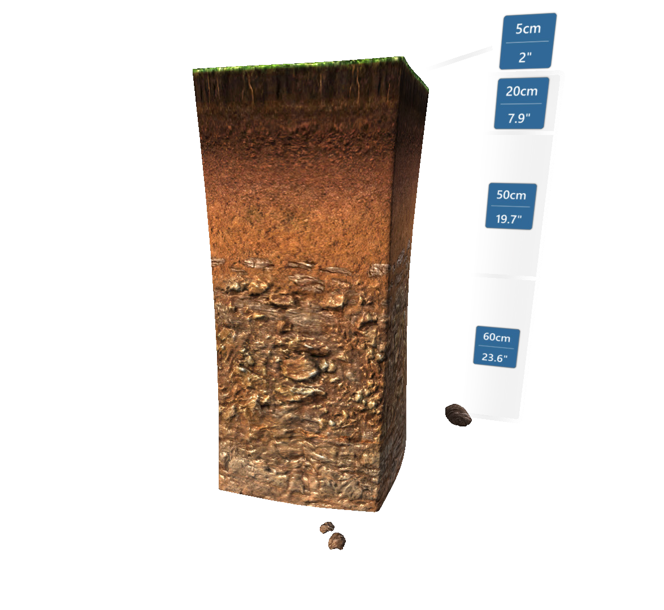
4. Colonization of dry land
10
min
About 1.5 billion years ago, eukaryotic cells began to form multicellular organisms. The earliest of these were probably algae. But it wasn’t until around 541-542 million years ago that the big boom of life forms began on Earth. The process was also slowed down by the various severe ice ages which Earth suffered during the Proterozoic. These periods are sometimes called “Snowball Earth”.
At the end of the Proterozoic eon came the so-called Cambrian Explosion. This was a major, sudden emergence of many living species, favored by the prevailing conditions on Earth. With this explosion, the last (and current) eon, the Phanerozoic, began. The first stage was the Paleozoic era. Animals still remaining in the water developed hard body parts, such as shells, skeletons, or exoskeletons. One of the benefits of their development for us is the easier and much more evident fossilization of their remains, providing us with more probable evidence about them. One of the most famous of these early, fossilized creatures was the “Trilobite”. Search in the Lifeliqe app for the model of this very well known prehistoric marine arthropod!
However, in this period there were also the first steps later leading to the colonization of dry land. Several million years ago, plants (probably algae) and fungi started to grow also on the edges of the water. This was possible due to more favorable atmospheric conditions than had earlier prevailed. Oxygen produced by photosynthesizing organisms allowed for breathing outside of water, and also allowed the creation of the protective ozone layer.
Oxygen present in the air also increased weathering rates, which together with the presence of early life forms on dry land led to creation of soil. This soil was in turn a hospitable place for other plant species to grow, and thus contributed to the first life on dry land. To see more about formation of soil and its structure, have a look at the “Soil Profile” model found in the Geology library.
Click to open in Lifeliqe
Click to open in Lifeliqe

Slide 8
5. Final wrap-up
5
min
At the end of the lesson, review the topic, focusing especially on the respective phases of the geological history of the Earth. You can ask questions like:
Can you name the eons?
When did the first eukaryotes appear?
In which eon was oxygen first produced?
Etc.

Slide 9

Thanks for using Lifeliqe's lesson plan!
Excite your students in learning science with 1,000+ more 3D models and lesson plans at online.lifeliqe.com

